Slide 1

PUBG Finish Placement Prediction Project
1st Project
shai for ai
data science internship

Slide 2
Problem Definition
How to know the best strategies to win PUBG? What is the percentage for the player to win a game? How many Hackers? What about AFK? And many other questions.
Through the Datasets We can answer these questions.
The Datasets have been collected through API.
We should predict the percentage of placement of some users (the Target)
The Datasets: Train Data ( 6.5 M instances ) | Test Data ( 1.9 M instances )
The submissions are evaluated on Mean Absolute Error

Slide 3
Project Pipeline ( Table Of Content )
Import Libraries and Read the Data
EDA ( Data Cleaning, Handle Missing Values, Correlation, Distribution of the Data, Questioning, Dive Into some Features )
Feature Engineering ( Feature Selection, Feature Preprocessing, Wrangle Function )
Split The Data into Training, Validation, and Testing sets
Accuracy Function
Building Different Machine Learning Models ( Linear, KNN, SVM, Decision Tree, XGBoost)
Hyperparameter Tuning

Slide 4
Data Describtion
The data has 29 columns with different fields like ( assists, kills, headshot kills, heals, etc )
All the Columns where Numerical Columns Except ( ID, group ID, match ID, match type )

Slide 5
1.1 Import Libraries
Import Libraries:
Pandas (Read the data) Numpy (do mathematical operations)
Matplotlib (Visualization) Seaborn (for statistical graphs)
Plotly Express (interactive graphs) Sklearn (for machine learning models)
XGBoost ( boosting ML algorithms Warning (to ignore warnings)
Google.colab ( read data from google drive)

Slide 6
1.2 Read Data
We’ve uploaded the data to google drive and read the data directly by linking google colab to our google drive account then read the data as usual using the pd.read_csv method.
Problem: The data was too big, so it would be difficult to upload the data to google colab every time
Solution: Read the data from google drive

Slide 7
2. EDA
2.1 Numerical & Categorical Features
2.2 Data Cleaning
2.3 Questions
2.4 Dive into Features

Slide 8
2.1 Numerical & Categorical Features
Almost all the features are numerical columns, except 4:
Match type: we have to handle it
ID, Group ID, match ID: We will drop them ( Orphan Columns )

Slide 9
2.2 Data Cleaning
2.2.1 Missing Values:
There was just one missing value, I dropped it.

Slide 10
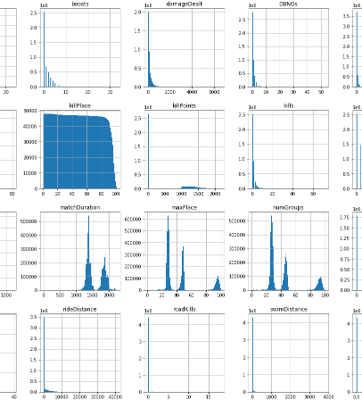
2.2.2 Distribution of the data
The data is pretty much messy
Outliers
Skewness

Slide 11
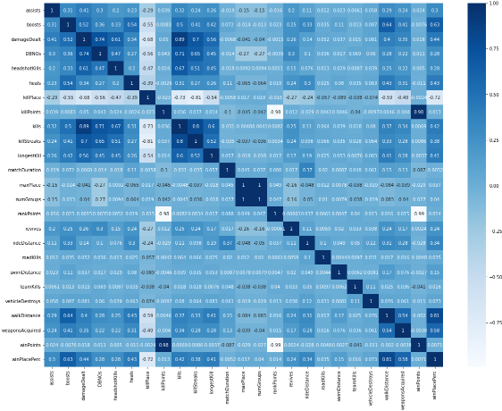
2.2.3 Correlation between Features

Slide 12

2.3 Questions:

Slide 13
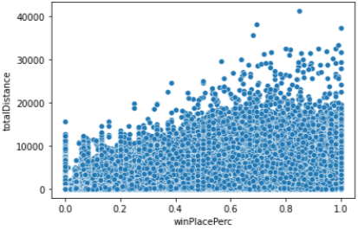
How Many Hackers?
In my opinion, hackers have some properties, They are:
1. Won Without Moving: 961

Slide 14
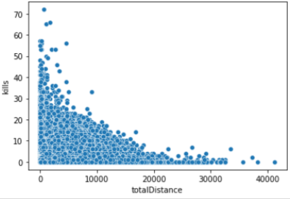
How Many Hackers?
In my opinion, hackers have some properties, They are:
2. Kill more than 20 without moving: 60

Slide 15
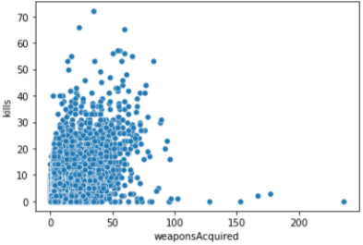
How Many Hackers?
In my opinion, hackers have some properties, They are:
3. Kill more than 5 with 0 weapon acquired: 15

Slide 16
How Many Hackers?
In my opinion, hackers have some properties, They are:
4. win a match with a duration of fewer than 4 minutes: 6

Slide 17
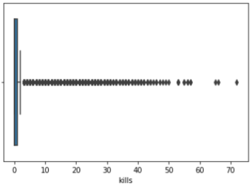
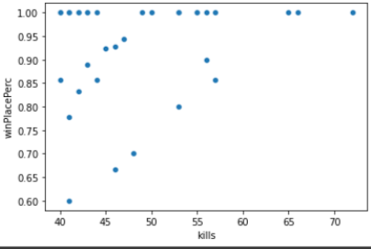
How Many Hackers?
In my opinion, hackers have some properties, They are:
5. kill more than 40 in one match and won the game: 23

Slide 18
How Many Hackers?
Total Hackers: 1,065

Slide 19
How Many AFK?
In my opinion, AFK’s have some properties, They are:
1. Zero Distance with Zero dealt damage: 88,204
Total AFK’s: 88,204

Slide 20
How Many Noobs?
In my opinion, Noobs have some properties, They are:
1. Played more than 30 minutes with zero kills: 870,856
2. Kill his teammate more than two times: 8,156
TOTAL = 879,012
Such a Noob Community! ☺

Slide 21
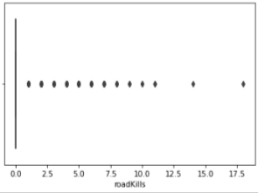
How Many Real Gamer?
In my opinion, Gamers have some properties, They are:
1. Kill more than 3 on the vehicle: 451

Slide 22
How Many Real Gamer?
In my opinion, Gamers have some properties, They are:
2. The percentage of headshot killings is more than 50% of the total kills: 307,592

Slide 23
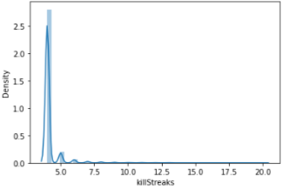
How Many Real Gamer?
In my opinion, Gamers have some properties, They are:
3. Kill Streak more than 3: 6,382

Slide 24
How Many Real Gamer?
Total Real Gamer: 314,425

Slide 25
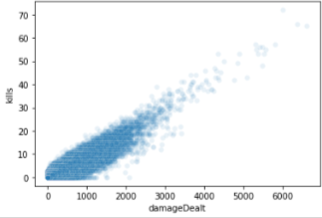
How Many Kill Stealer?
In my opinion, Kill Stealers have some properties, They are:
1. High number of kills with low damage dealt: 200

Slide 26
Percentage of Winning?
0.03%

Slide 27
Making the Percentage of Winning Higher?
Walk more
Acquire more weapons
Drink your boost

Slide 28
2.4 Dive into Features
I’ve dived into the most important features for the target feature in handling Outliers, these columns are:
Boosts
Kill Place
Walk Distance
Weapons Acquired
Damage Dealt
Heals
Kills

Slide 29
3. Feature Engineering

Slide 30
Feature Selection (drop Orphan Columns)
ID
Group ID
Match ID

Slide 31
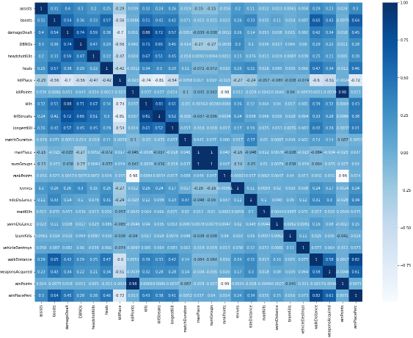
Feature Selection (drop correlated features)
From the Image we can see that:
maxPlace & numGroups are identical
winPoints & killPoints have 98% correlation
winPoints & rankPoints have 99% anti-correlation
rankPoints & killPoints have 98% anti-correlation
We will drop 3 of them ( winPoints, killPoints, numGroups )

Slide 32
Feature Engineering ( Extract new Features )
Make a new feature “Match Duration per Minute” because the old feature was “match duration per second”, and it would be more helpful if we made the match duration in minutes.
Make a new feature “Total Distance” which has the value of summing values of 3 features ( walk, swim, and ride distance )
Make a new feature “Heal and Boosts” which has the sum value of heal and boost features ( BOLD MOVE )

Slide 33
Feature Preprocessing
Standard Scaler for the “Longest Kill” feature → to make the scale for the values in the data frame close to each other.
Take the LOG for the “damage Dealt, total Distance” → to fix the distribution for those features ( make them close to normal distribution rather than the skewness )
One Hot Encoder for the “match Type” feature → to handle the categorical data, which produces 16 new features ( Ordinal Encoder in the BOLD MOVE )

Slide 34
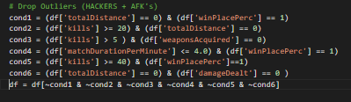
Feature Preprocessing
Drop Outliers (Hackers, AFK’s) ( BOLD MOVE )
Through some conditions for filtering the data frame

Slide 35
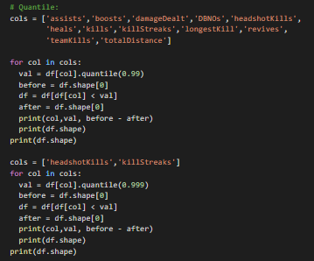
Feature Preprocessing
Remove Outliers using Quantile Method ( BOLD MOVE )
Remove the top 1% values for specific columns

Slide 36
Wrangle Function
All of the feature engineering steps had been written on a function called wrangle.
This function has one parameter, the path for the dataset.
This function starts with reading the datasets, performs all the steps I mentioned before, and returns the data frame.
The purpose of this function is to reuse the steps on the test dataset, without needing to rewrite the code on the test set.

Slide 37
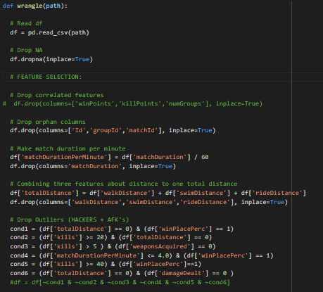
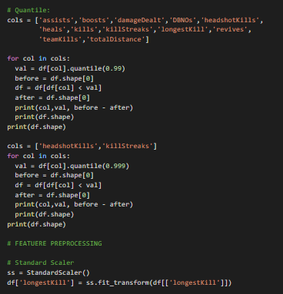
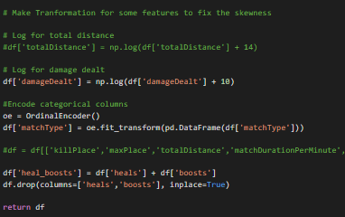
The Wrangle Function

Slide 38
4. Split the Data
Split the data into:
Training Set → For building and training the model. (95% of the data)
Validation Set → For Hyperparameter Tuning. (2.5% of the data)
Test Set → To test the model performance. (2.5 of the data)

Slide 39
5. Accuracies Function
This function is about the give the accuracy of the model on the different sets (train, validation, and test)
The purpose is to reuse it every time we built a new machine learning model to test its performance
To test model performance I’ve chosen the metric R2 score and the MAE ( Mean Absolute Error ) as the evaluation of my model performance
The input for the function is the model and it returns a data frame with the accuracies.

Slide 40
Accuracies Function
The data frame has 4 main values for each metric:
baseline: to see the minimum accuracy ( using the mean of the target feature )
Train set: to see if the model performs better than the minimum accuracy
Validation Set: to see if the model is overfitted to the train set
Test Set: to see if the model is well-generalized and there is no data mismatch between validation & test sets.

Slide 41
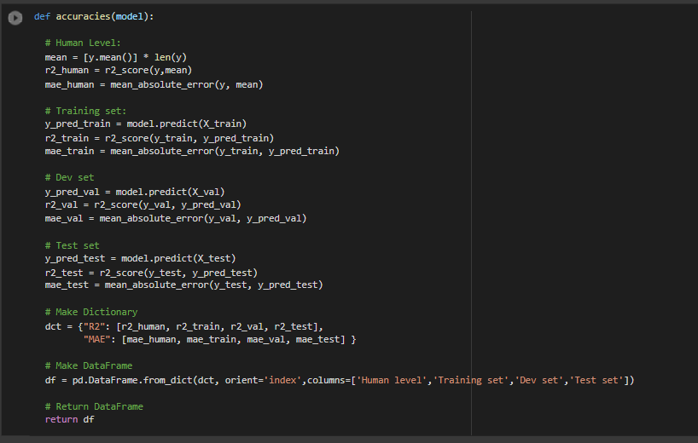
Accuracies Function Code

Slide 42
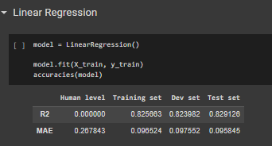
Example of Accuracy Function with the Linear Regression Model

Slide 43
6. Building Different Machine Learning Models
I’ve tried multiple machine learning algorithms to test which one performs the best
The Models we’ve built:
Linear Regression
KNN (K Nearest Neighbor)
SVM (Support Vector Machine)
Decision Tree
XGBOOST

Slide 44
Pick the best model
I’ve chosen the xgboost model which performs the best:
Xgboost performance:
 | Base Line | Training Set | Validation Set | Test Set
R2 | 0.0 | 0.918 | 0.919 | 0.919
MAE | 0.267 | 0.063 | 0.062 | 0.062

Slide 45
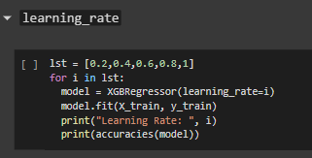
7. Hyperparameter Tuning (learning rate)
Learning Rate Tuning:
I found that 0.8 is the best value for the learning rate hyperparameter

Slide 46
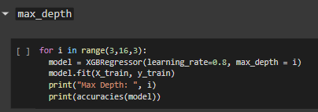
7. Hyperparameter Tuning (max depth)
Max Depth Tuning:
I found that 3 is the best value for the max depth hyperparameter

Slide 47
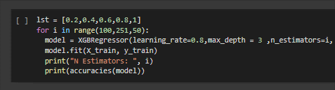
7. Hyperparameter Tuning (n estimators)
N Estimators Tuning:
I found that 250 is the best value for the n estimators hyperparameter

Slide 48
Finish the Hyperparameter Tuning Phase
After Iteration I’ve concluded that these values for hyperparameter give the best performance of the model:
Learning rate: 0.8
N estimators: 250
Random state: 42
Max depth = 3
Objective = reg:squarederror
Verbosity = 0

Slide 49
8. Communication Results

Slide 50
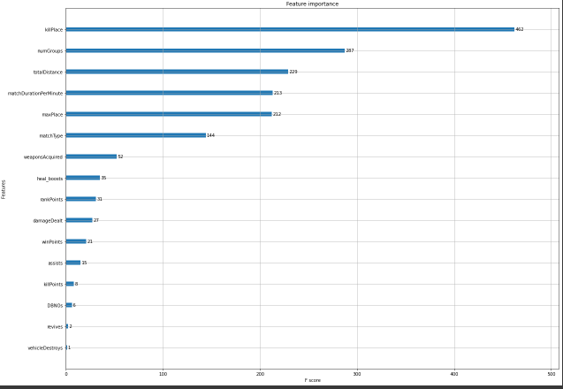
Feature Importance for the Model

